Slide 1
How great leaders inspire action
-Simon Sinek

Slide 2
For Example
Why best companies are so innovative ?
Yet they’re just a company like others.
Holdings:
  Same Access.
  Same Talent.
  Same Agencies.
  Same Consultants.
  Same Media.
They Why they Different?

Slide 3
There is a pattern
All Great Leader and inspiring Organizations in the world
  Think.
  Act.
  Communicate.
Exact same way and it’s the complete opposite to everyone else.
What is that ?

Slide 4

IDEA!

Slide 5
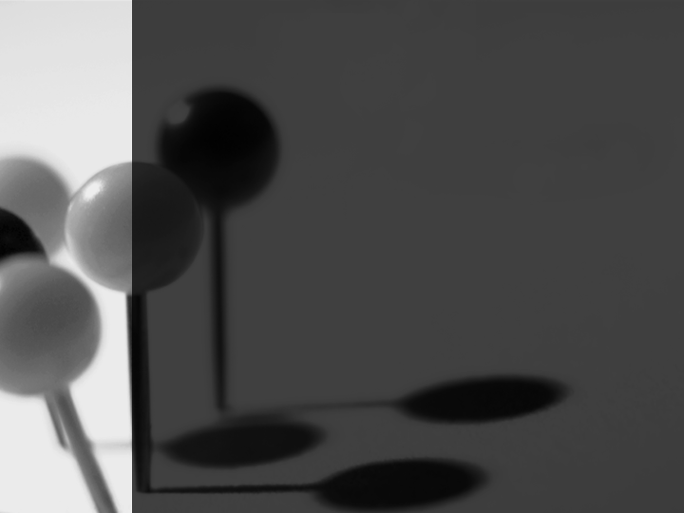
Golden Circle
WHAT ?
HOW ?
Why ?

Slide 6
MARKETING MESSAGE
Everyone
Inspiring Leaders
We make great products.
They are beautifully designed, simple and easy to use.
Want to buy one?
Everything we do, we believe in challenging.
We believe in thinking differently which make our product beautifully designed.
Making easier to user.

Slide 7
REASON
WHAT ?
WHY ?

Slide 8


